Slide 1
Java Basics
Week 2 / 3

Slide 2
Review of Last Week

Slide 3
Comparisons & Conditions

Slide 4

Comparisons
With what we know about variables, we can only
Store values
Modify values
One noticeable thing missing is comparing two
different values -- there’s more operators to learn.
These operators report a boolean (true/false) whether a certain condition between two values applies (e.g. greater than, less than)

Slide 5
Comparison Operators
Comparison operators allow you to compare numeric expressions. The equality comparison also works on booleans.
Operator | Description | Example
== | equal | 1 == 2 // false false == false // true
!= | not equal | 1 != 2 // true false != true // true
<, <= | less than, less than or equal to | -10 < 0 // true -10 <= 0 // true
>, >= | greater than, greater than or equal to | 10 > 0 // true 10 >= 0 // true

Slide 6
Logical Operators
Logical operators relate boolean expressions together.
Operator | Description | Example
! | not inverses value | !true // false
&& | and true if both statements are true | true && true // true
|| | or true if at least one statement is true | true || false // true
== | equal | 1 == 2 // false false == false // true
!= | not equal | 1 != 2 // true false != true // true

Slide 7
Conditionals
Currently, booleans, logic operators, and comparison operators can report the state of values in a program, but...
They cannot change how a program will execute!
Conditionals allow the code to conditionally run certain parts of the program
// we have values to represent shaurya,
// the current day, and his birthday
String name = "Shaurya";
int birthday = 32;
int dayOfYear = 32;
// we can even store a value saying whether // or not it's his birthday, but...
boolean isToday = (birthday == dayOfYear);
// how can we print Happy birthday Shaurye
// only when isToday is true??

Slide 8
If Statements
If statements follow the structure
if (boolean) {
Do Code
}
If the boolean in the parentheses is true, then the code in the block is run. Otherwise, Java skips over it.
boolean isToday = (birthday == day);
if (isToday) {
System.out.println("Happy birthday " + name);
}
double speed = 5.2;
if (speed >= 5.0) {
System.out.println("Too fast!");
speed -= 0.1;
}

Slide 9
Else Statements
You can add an else after the end of the if statement
If the if statement is skipped over (the boolean is false), then the code block in else is run.
double speed = 5.2;
if (speed >= 5.0) {
System.out.println("Too fast!");
speed -= 0.1;
} else {
System.out.println("Speed normal");
}

Slide 10
Else if Statements
An else if will run if the previous if/else if has reported false.
You can add any amount of else ifs after an if.
They represent extra conditions or cases to check after previous if or else ifs. Similar to if statements, if the boolean is true, then the code block inside is run.
double speed = 5.2;
if (speed >= 5.0) {
System.out.println("Too fast!");
speed -= 0.1;
} else if (speed >= 3.0) {
System.out.println("Normal speed");
} else {
System.out.println("Too slow!");
speed += 0.1;
}

Slide 11
QUIZ
Print out if a int variable is even or odd.
Int stored in a variable
Use if statements and %

Slide 12
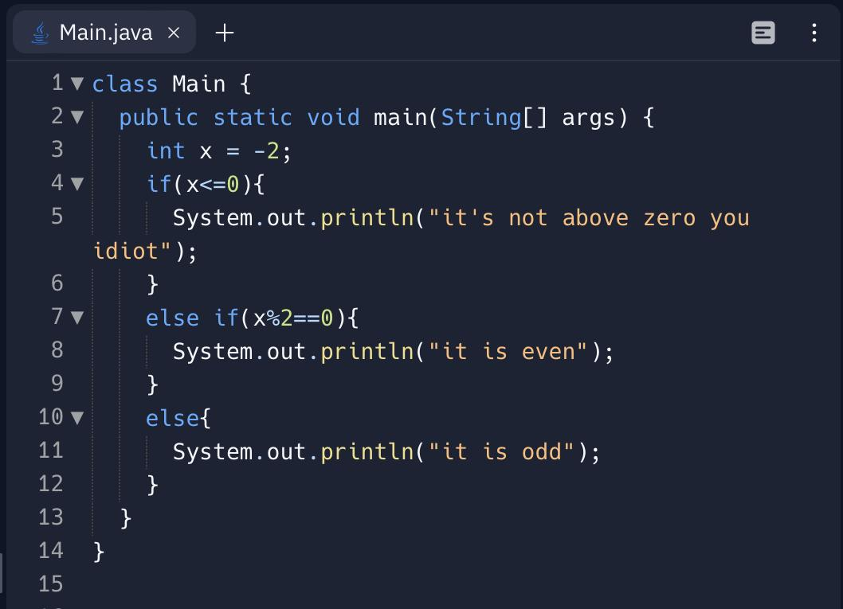
SOLUTION

Slide 13
Arrays

Slide 14

Arrays
The data types we’ve seen so far only contain one value, but what if we want to process dozens, or even hundreds, of related values?
In Java, arrays allow you to refer to multiple values by one variable
Each value in the array is called an element.
Arrays can store elements of any data type.
Each array has a type indicating which kind of data is being stored.
Notes:
We’ll see how we can even use for loops on arrayus

Slide 15
Array Types
Creating a array is just like creating any other variable, except the type and possible values differ
Type of an array: type[]
Ex. int[], double[], String[]
Opening and closing square brackets right after the element type show that a variable is an array.
// declaring different types of arrays
// array of ints
int[] intArray;
// array of doubles
double[] doubleArray;
// array of strings
String[] stringArray;
Notes:
After this be like.. So we can declare an array and we have the type… but what about the possible set of values

Slide 16
Array Assignment
There are two ways to make an array.
One kind makes an empty array with a number of elements:
Ex. int[] arr = new int[10];
The second kind makes an array with elements already set:
Ex. int[] arr = {1, 2, 3};
// making different types of arrays
// make an empty array
double[] doubleArray = new double[10];
// set the array values
int[] intArray = {2, 5, 1, 7, 1};
// set the array values
String[] stringArray = {"a", "lol", "selym3"};
Notes:
Making empty array is more important than filled

Slide 17
Getting Array Values
An index is the position of a value in an array.
The first element in the array is has index 0.
In the array {6,9,4}
Index 0 is 6, index 1 is 9, and index 2 is 4
You can access the value with:
arrayName[index]
int[] array = {6, 9, 4};
System.out.println(array[1]);
// Prints 9
array[0] = 3;
System.out.println(array[0]);
// Prints 3

Slide 18
Array Elements
You can treat chosen elements like any other value or variable of the same data type:
Modify:
arrayName[index] += 5
Print:
System.out.println(arrayName[index])
Use with operators:
arrayName[index] == 5
int[] array = {6, 9, 4};
System.out.println(array[1]);
// Prints 9
array[0] = 3;
System.out.println(array[0]);
// Prints 3

Slide 19
Sized Arrays
One important thing to note is that the size of arrays cannot be changed, which means that there is are only a limited number of valid indices
These indices go from 0 up to 1 less than the length of the array
To find the length of an array in the program, use dot length
arrayName.length
int[] n = { 6, 9, 4 };
//indices: 0 1 2
//array length is 3
//max index is 2
//length - 1 = 2 = max index
int nl = n.length;
//access length of array
// with dot length

Slide 20
queeeez
DO NOT TOUCH
Is this a valid code fragment? String[] stringArray = {4, "lol", "selym3"}; | no
What is the value of arr[0] in the following code String[] arr = {"hamburger", "cheeseburgerg", "ooga booga"}; | "robgobtics"
What is the value of x in the following code int[] arr = {1, 2, 3}; int[] arr2 = {5, 6, 7}; int x = arr2[arr[0]]; | 6
DO NOT TOUCH
DO NOT TOUCH

Slide 21
Looping

Slide 22

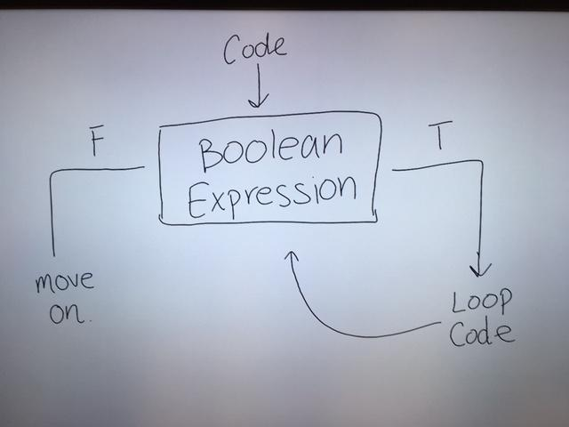
Looping
Writing the same line of code over and over again is time consuming and prone to errors.
Loops help us prevent that!
Loops are a tool used to repeat a set of instructions forever, or until it reaches a certain condition that tells it to stop.
There are 3 (three) types of loops in Java
Notes:
(for example, applying some code to every value of an array)

Slide 23
While Loops
The first type of loop is a while loop, which is in the form:
while (aBoolean) {
code
}
To enter the loop initially, the boolean expression must be (or evaluate to) true
Once inside the loop, the block of code is executed, Java goes back to the expression.
If the expression is true again, the block of code is executed again :O
public class FirstWhileLoop {
public static void main(String[] args) {
int age = 0;
int death = 5;
while (age <= death) {
System.out.println(age + " years old");
System.out.println(death-age + " years
left to live");
age = age + 1;
}
System.out.println("Unfortunate, you died!");
}
}

Slide 24
For loops
for (declaration; check; increment) {
code
}
When looping, you typically have a counter variable and increment it to tell when to stop.
For loops are meant to condense this into one line
The first part is a variable declaration
The second part is the while loop boolean check
The third part occurs after each run, and is usually an increment or decrement
All of these are optional
int death = 15;
for (int age = 0; age <= death; age++) {
// declare variable; boolean check; update
System.out.println(age + " years old");
System.out.println(death - age + " years left to live");
}
System.out.println("Unfortunate, you died!");
Notes:
Idk how to phrase this someone help

Slide 25
Looping through arrays
With for loops (or while loops), arrays can be looped through and accessed like so:
This is annoying though, and because this pattern is so common, Java has another way to loop through arrays!
int[] arr = {1, 2, 3};
for (int i = 0; i < arr.length; i++) {
System.out.println(arr[i]);
}
Notes:
This is similar to how counting is a common operation, so they added for loops

Slide 26
POP QUIZ 🤯🤯🤯
It’s time to practice loops! Try to use both for and while loops for the following exercises:
Print numbers from 1 to 10.
Print the sum of all elements in an array of integers.
Make your own array with at least 5 of your favorite integers
Print the maximum value in an array of non-negative integers.
Make your own array with at least 5 of your favorite integers >= 0
Print the INDEX of the maximum value in an array of non-negative integers
Make your own array with at least 5 of your favorite integers >= 0
THINK: would it be possible to use an enhanced for loop for this problem?

Slide 27
Answers - I
To print all of the numbers from 1 to 10, you simply have to create and increment a variable from 1 to 10, and print the value of the variable.
The way the counter is created varies from for to while loops
public class Answer {
public static void main(String[] args) {
// Using for loop
for (int i = 1; i <= 10; i++) {
System.out.println(i);
}
// Using while loops
int i = 1;
while (i <= 10) {
System.out.println(i);
i++;
}
}
}

Slide 28
Answers - II
To find the sum of all the elements in an array, you need to loop through the entire array
Create a variable before hand to accumulated value as the loop is running
A counter must be created for a while loop
public class Answer{
public static void main(String[] args) {
int[] array = {5,6,4,46,7,86,34,63478,478};
// for loop
int sum = 0;
for (int value : array) {
sum += value;
}
System.out.println(sum);
// while loop
int i = 0;
sum = 0;
while (i < array.length) {
sum += array[i];
i++;
}
System.out.println(sum);
}
}

Slide 29
Answers - III
Create an integer variable max with value 0
We chose 0 because in an array of non-negative integers, every value is >= 0
Loop through the array, and if the number is greater than the current max value, reassign max to the current number
Print max once the looping is finished
public class Answer {
public static void main(String[] args) {
int[] arr = { 2, 5, 3, 8, 29, 47, 1, 0, 7, 3 };
// for loop
int max = 0;
for (int num : arr) {
if (num >= max) {
max = num;
}
}
System.out.println(max);
// while loop
max = 0;
int i = 0;
while (i < arr.length) {
if (arr[i] >= max) {
max = arr[i];
}
i++;
}
System.out.println(max);
}
}

Slide 30
Answers - IV
The idea is the same as answer 3, but this time we want an additional variable to store additional information
We still compare every value in the array to maxValue to find the max value, but now whenever it’s found we can also update the maxIndex
Because it is required to store the index when a new max value is encountered, you cannot use an enhanced for loop
int[] nums = { 3, 2, 100, 5, 7 };
int maxValue = 0;
int maxIndex = 0;
for (int i = 0; i < nums.length; ++i) {
if (nums[i] > maxValue) {
maxValue = nums[i];
maxIndex = i;
}
}
System.out.println(maxValue + ", " + maxIndex);
maxValue = 0;
maxIndex = 0;
int i = 0;
while (i < nums.length) {
if (nums[i] > maxValue) {
maxValue = nums[i];
maxIndex = i;
}
++i;
}
System.out.println(maxValue + ", " + maxIndex);

Slide 31
Activity - Loops
Use a for loop to compute the sum of integers from 0 to n, where n is some integer greater than 0 in your code.
Print the sum after your loop
Create an array of integers of size n, where n is some integer in your code. Fill every index of the array with the corresponding factorial value
E.g. index 0 should have 0! = 1, index 1 should have 1! = 1, index 2! = 2, index 3! = 6, etc.
n! = n * (n-1) * (n-2) … 2 * 1

Slide 32
Answer - I
NOTE: n can be anything greater than or equal to 0
Count from 1 to n and add each value to another variable that holds the result
int n = 300;
int sum = 0;
for (int i = 1; i <= n; ++i) {
sum += i;
}
System.out.println(sum);

Slide 33
Answer - II
Start by choosing an int n and creating factorials
Notice that if you have factoria for (n-1)!, if you multiply by n you have n!
For example, 3! * 4 = 4!
This means that the value at an index can be calculated by multiplying the index by the value before the one being calculated
This is because the value before represents (n-1)! and if the index is n, (n-1)! * n = n!, and we can store that in the array.
int n = 10;
int[] factorials = new int[n];
factorials[0] = 1;
for (int i = 1; i < n; ++i) {
factorials[i] = i * factorials[i-1];
}
for (int factorial : factorials) {
System.out.println(factorial);
}

Slide 34
Activity - More Loops
Use a for loop to compute 1 + ½ + ⅓ + ¼ …. up to 1/n where n is some integer variable in your code.
This sum is called the Harmonic sum -- print the value you’ve computed after the loop
Use a loop to find how many times the harmonic sum must be continued to be greater than 10
(e.g. 1 is not greater than 10, add ½ to 1, the total is not greater than 10, add ¼)
Report how many iterations it took to get past 10
Create a for loop that computes the sum 1 - ½ + ⅓ - ¼ + ⅕ up to 1/n where n is some integer in your code.
Print the result to the console
The sum is an approximation of ln(2), which can be found with Math.log(2) -- also print this value

